Slide 1
Project #2: Extract, Transform, and Load
Group 3: Bill Johnson, Donterrius Daniels, Tamekia Phillips, Ramirra Marshall, Henry White, Adam Armagost, Ryan “Fin” Finley, Chineze Okpala, Evan Mickler, Antione Perrymon, James Niu

Slide 2




Intro
Movies
~9,000 +
Project Proposal:
Our Team's goal is to extract and transform Movie data from various sources and combine them into a single searchable database to build comprehensive movie profiles.
Data Sources -
Movies
700,000 +
Movies
~17,000 +
Movies
~83,000 +

Slide 3






ETL Process Overview Plan
GT_MOVIES_DB
IMDb
Movies
ratings
MetaCritic
Rotten Tomatoes
Transform & Load
Aggregation
Pull Request
Joins
GT_MOVIES_DB
Extraction & Transformation
Start
Phase 1
Phase 2
Finish
Data Extraction & Cleaning to MongoDB

Slide 4
Extraction Process
[List of ids]
For Loops with API Call
Dictionary of Data
Write to .csv
[List of titles]
WHAT WAS OUR EXTRACTION PROCESS?

Slide 5
RottenTomatoes, MetaCritic, IMDB Cleaning
COMMON INDEX: IMDB_ID
LANGUAGE: ENGLISH
TIME RANGE
ORIGINAL RELEASE DATE (ALL)
STREAMING RELEASE DATE (ROTTENTOMATOES)
TITLE (ALL)
DIRECTOR(S) (ALL)
AGE RATING (ALL)
GENRE(S) (ALL)
AUDIENCE RATING/REVIEWS (ALL)
RATING BY SOURCE RANGE
BUDGET (ALL)
RUNTIME (both)
MOVIE HOMEPAGE
PRODUCTION COMPANY (ALL)
Steps
Build Schemas
Cleaned Data by dropping non-relevant Columns
Joined csv files within same database.

Slide 6
Joining Process
merge_df = pd.merge(metacritic, rottentomatoes, on="movie_title")
imdb = imdb.rename(columns={'title':'movie_title'})
Load
merge_df2 = pd.merge(merge_df, imdb, on="movie_title")
moviedb = imdb.rename(columns={'imdb_id':'imdb_title_id'})
merge_df3 = pd.merge(merge_df2, moviedb, on="imdb_title_id")
merge_df3.to_csv('Final_Movie_DB', header=True, index=False)
WHAT WAS OUR JOINING PROCESS?
We used inner joins between the different files starting with the MetaCritic Data because it has the fews records (~9,000 movie titles). Movie_Title was used as the common key for merging RottenTomatoes & IMDb; due to this being the most common link between data sets. The imdb_title_id was used to join this output dataset to the Movie DB data to keep the data due to this data have the same movie titles with different release years.

Slide 7
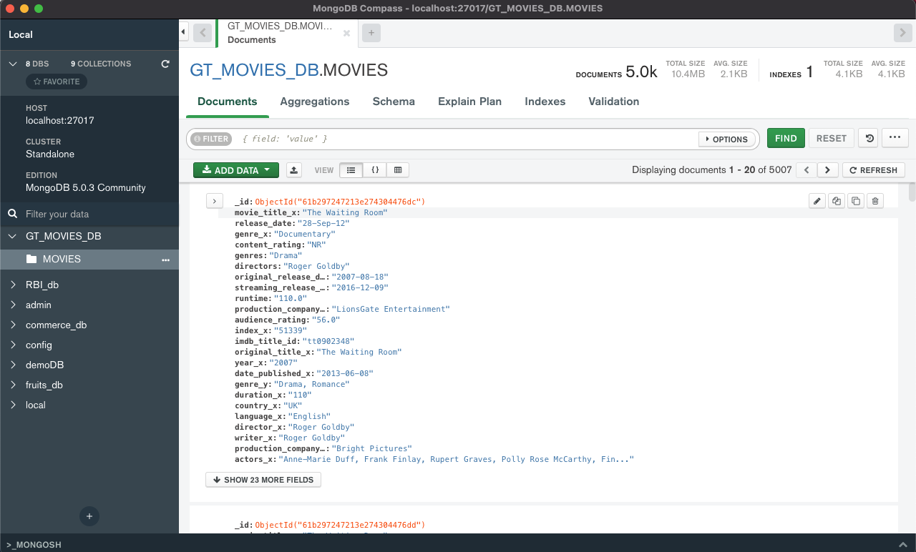
Final DataBase
Database Summary
5000 Movies
47 Unique data points per movie
Known Issues in Data
Duplicated Movie Titles or Names
Unnecessary Data like ‘index’
Uncertain Data like production company_y

Slide 8
Available Movie Data
"movie_title_x":"The Waiting Room",
"release_date":"28-Sep-12",
"genre_x":"Documentary",
"content_rating":"NR",
"genres":"Drama",
"directors":"Roger Goldby",
"Original_release_date":"2007-08-18",
"Streaming_release_date":"2016-12-09",
"Runtime":"110.0",
"production_company_x":"LionsGate Entertainment",
"Audience_rating":"56.0",
"Index_x":"51339",
"Imdb_title_id":"tt0902348",
"original_title_x":"The Waiting Room",
"Year_x":"2007",
"Date_published_x":"2013-06-08",
"genre_y":"Drama, Romance",
"Duration_x":"110",
"country_x":"UK",
"language_x":"English",
"director_x":"Roger Goldby",
"writer_x":"Roger Goldby",
"production_company_y":"Bright Pictures",
"actors_x":"Anne-Marie Duff, Frank Finlay, Rupert Graves, Polly Rose McCarthy, Finlay Kenny Tighe, Adrian Bower, Daisy Donovan, Ralf Little, Peggy Batchelor, Phyllida Law, Zoe Telford, Christine Bottomley, Leader Hawkins, Paul Popplewell, Elizabeth Perry",
"description_x":"Two complete strangers, Anna and Stephen, are brought together by chance by an elderly man who waits for his wife on a station platform. Their fateful meeting acts as a catalyst for them to...",
"Avg_vote_x":"6.4",
"Votes_x":"619",
"Reviews_from_users_x":"3.0",
"Reviews_from_critics_x":"11.0",
"original_title_y":"The Waiting Room",
"Year_y":"2007",
"date_published_y":"2013-06-08","genre":"Drama, Romance","duration_y":"110","country_y":"UK","language_y":"English","director_y":"Roger Goldby","writer_y":"Roger Goldby","production_company":"Bright Pictures","actors_y":"Anne-Marie Duff, Frank Finlay, Rupert Graves, Polly Rose McCarthy, Finlay Kenny Tighe, Adrian Bower, Daisy Donovan, Ralf Little, Peggy Batchelor, Phyllida Law, Zoe Telford, Christine Bottomley, Leader Hawkins, Paul Popplewell, Elizabeth Perry","description_y":"Two complete strangers, Anna and Stephen, are brought together by chance by an elderly man who waits for his wife on a station platform. Their fateful meeting acts as a catalyst for them to...","avg_vote_y":"6.4","votes_y":"619","reviews_from_users_y":"3.0","reviews_from_critics_y":"11.0"}

Slide 9
Given More Time
Current State
Future State
Known Issues in Data
Duplicated Movie Titles or Names
Unnecessary Data like ‘index’
Uncertain Data like production company_y
Clean Up Merge Process to include additional merge parameters like movie_title
Drop Duplicate Values
Drop unnecessary values like ‘index’
Rename uncertain data like production company_y to be reflective of data source

